Slide 1
CAPSTONE PROJECT EDA -1 ON AIRBNB BOOKING ANALYSIS.
BY TEAM BRAINSTORMERS:
VISHAL TOMER
RAHUL VERMA
SUMIT SHARMA
KHUSHBOO KHOBRAGADE
KHUSHBOO KHANRAH

Slide 2
PROBLEM STATEMENT
For this project we are analyzing Airbnb’s New York City(NYC) data of 2019. NYC is not only the most famous city in the world but also top global destination for visitors drawn to its museums, entertainment, restaurants and commerce.
Our main objective is to find out the key metrics that influence the listing of properties on the platform. For this, we will explore and visualize the dataset from Airbnb in NYC using basic exploratory data analysis (EDA) techniques.
Data analysis on thousands of listings provided through Airbnb is a crucial factor for the company ,We will be finding out the distribution of every Airbnb listing based on their location, including their price range, room type, listing name, and other related factors.

Slide 3
UNDERSTANDING THE DATA
There are 49,000 observations with various types of field in our dataset.
Id
Name
Histid
Hostname
Neighbourhood group
Neighbourhood
Latitude
Longitude
Room type
Price
Minimum nights
Last review
REVIEW PER MONTH
availabilty_365

Slide 4
AGENDA we try to answer following question :-
MOST Busiest host and why
Minimum nights neighbourhood groups
Price area on basis of minimum nights

Slide 5
AGENDA (cont.):-
Traffic areas with room type in minimum nights
Highest last reviews with months .
Highest price for listing as an average price

Slide 6
HOST LISTING IN DIFFERENT NEIGHBOURHOOD GROUPS
NEIGHBOURHOOD
GROUPS
BROOKLYN
BRONX
QUEENS
MANHATTAN

Slide 7
ROOM TYPE WITH RESPECT TO PRICE IN DIFFERENT NEIGHBOURHOOD
ROOM TYPE | PRICE
ENTIRE HOME | 1K
PRIVATE ROOM | 2.5K
SHARED ROOM | 0.8K
BRONX

Slide 8
BROOKLYN
NEIGHBOURHOODS ROOM TYPE
ROOM TYPE | PRICE
ENTIRE HOME | 10K
PRIVATE ROOM | 7.5K
SHARED ROOM | 0.725K

Slide 9
MANHATTAN
ROOM TYPE | PRICE
ENTIRE HOME | 10K
PRIVATE ROOM | 9.99K
SHARED ROOM | 1K
NEIGHBOURHOODS ROOM TYPE

Slide 10
QUEENS
NEIGHBOURHOODS ROOM TYPE
ROOM TYPE | PRICE
ENTIRE HOME | 2.6K
PRIVATE ROOM | 10K
SHARED ROOM | 1.8K

Slide 11
Maximum number of night stayed in which room type.
Max. min. nights

Slide 12
Number of reviews with respect of room type neighbourhood group
Max. num of views

Slide 13
What can we learn about different hosts and areas?
We can see most number of liftings are from Manhattan created sonder(NYC).
As we can see least number of liftings are from Manhattan created corporate housing.

Slide 14
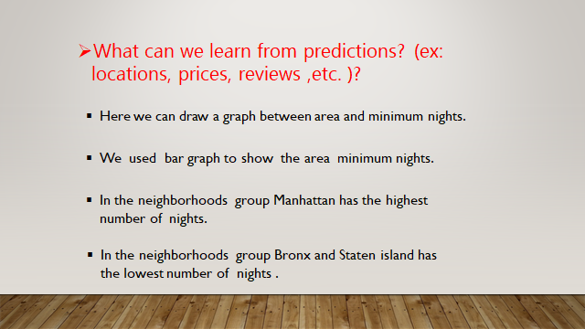

Slide 15
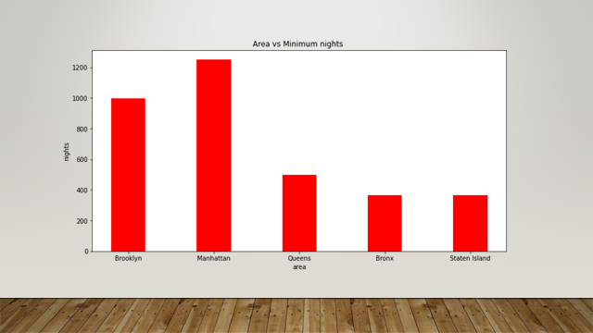

Slide 16
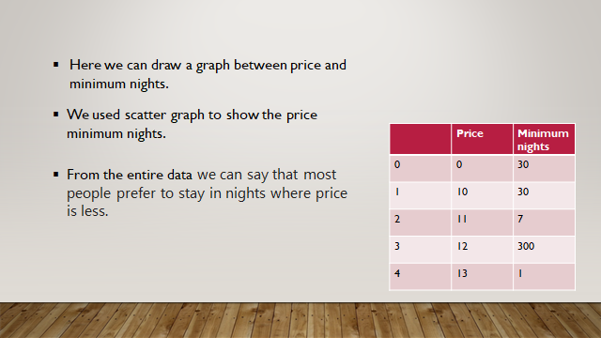

Slide 17
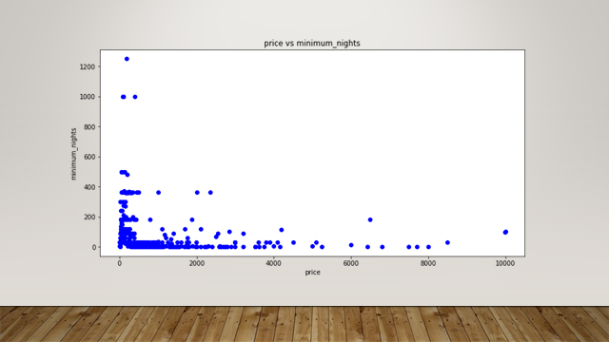

Slide 18
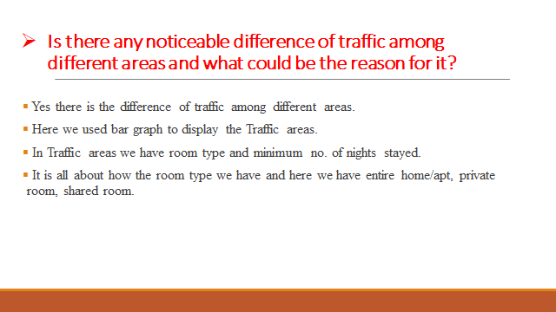

Slide 19
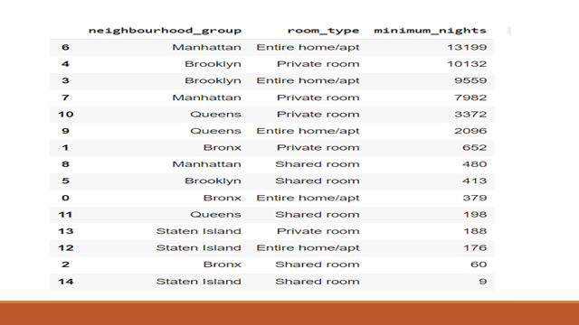

Slide 20
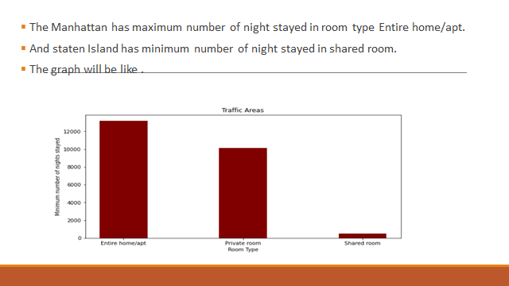

Slide 21
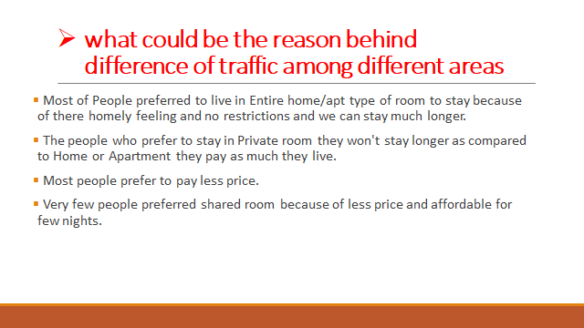

Slide 22
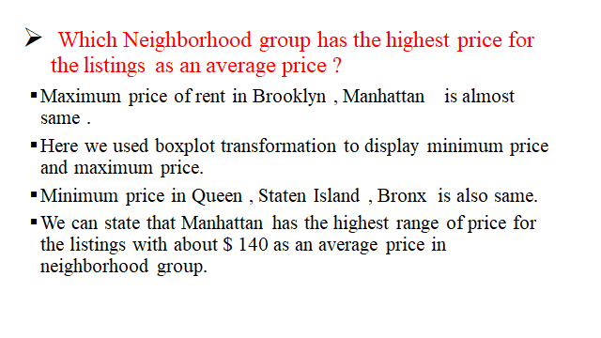

Slide 23
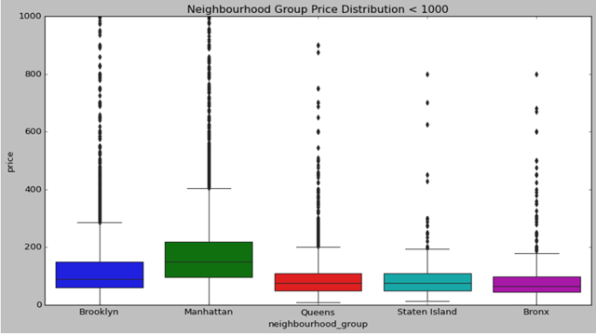

Slide 24
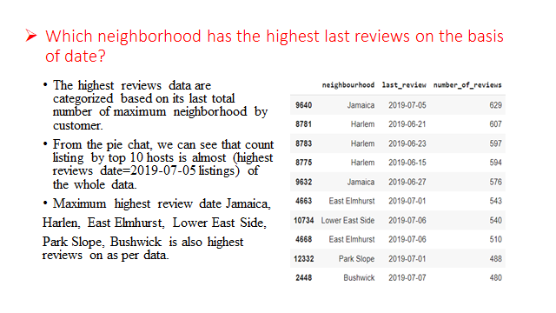

Slide 25
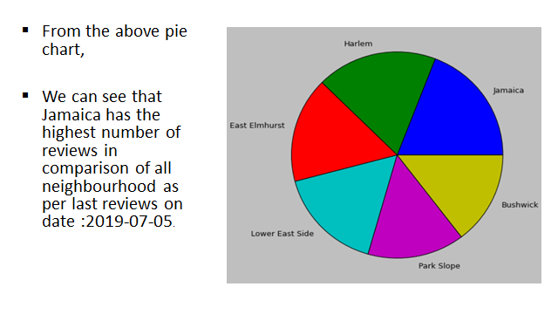

Slide 26
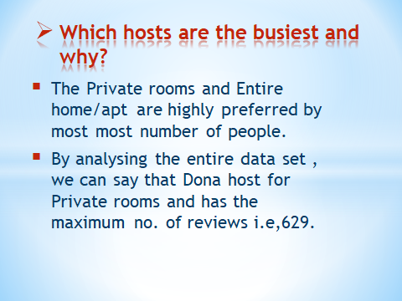

Slide 27
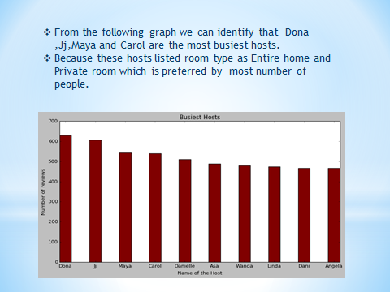

Slide 28
Conclusion:-
AFTER DOING ANALYSIS OF AIRBNB BOOKING 2019 BOOKING DATA WE GET A CONCLUSION.
* MANHATTAN HAS A MAXIMUM HOST LISTING COUNT.
* BROOKLYN NEIGHBOURHOOD GROUP HAS A MAXIMUN NIGHT .
* DONA IS A BUSIEST HOST IN PRIVATE ROOM TYPE.
* MANHATTAN GROUP HAS A HIGHEST TRAFFIC IN ENTIRE HOME/APT ROOM TYPE.
* MANHATTAN GROUP ALSO HAS A HIGHEST PRICE IN COMPARISON OF OTHER GROUP WITH MAXIMUM NIGHT STAYS.
* JAMAICA HAS A MAXIMUM NO. OF REVIEWS IN COMPARISON WITH OTHER .

